Slide 1
Predictive Sentiment
Zamena Jaffer
x
General Assembly

Slide 2
Problem Statement
Does the sentiment expressed in article titles published over the last 5 years have an impact on the volume of shares an article receives?
Current State
The Gap
Future State
A client has run a content hub for the last 3 years, publishing articles about the energy industry on a regular basis.
They have set benchmarks for their KPI’s and have noticed that the ‘volume of shares’ KPI has been below benchmark for a few months in a row.
The client would like produce content that drives shares to meet benchmark.
I have noticed from an analyst stand point, article titles that express a more positive sentiment receive a higher volume of shares.
By analysing the last 3 years worth of articles along with shares and sentiment I will look for a correlation between positive sentiment and article shares.
The analysis will allow for the build of a predictive model that will analyse a range of article titles with differing emotional intent before being published, to predict the volume of shares they may receive, optimizing audience engagement and aiding the decision making at the content development level.

Slide 3
The Data Set
Hypothesis
Goals
Risks
There was an assumption here that articles title that express sentiment will correlate with volume of shares that article receives.
The null hypothesis for this data set is:
Articles titles written with the expression of positive sentiment receive a high volume of shares
Therefore, the alternative hypothesis for this data set will be:
Articles titles written without the expression of positive sentiment receive a high volume of shares
The primary goal of this analysis was to prove the correlation between sentiment expressed within article titles and article shares.
Following this, the success metric for this project will be to use the model built to predict the number of shares an article will receive based on the language used to write the title, with a statistical significance of 5% or less (p value ≤ 0.05).
There were limitations around this project to be aware of, including:
Some article titles may be biased in that paid promotion may have been run on them, driving more visitors to the article and in turn increasing shares
No publication date data is included
Articles posted a long time ago may have accumulated more shares than those posted more recently
There are less than 500 articles published, meaning fewer rows and therefore a less robust model
Articles that have not been shared should also be included
The data set was built using BuzzSumo to export all articles published in the last 5 years and article format data. Google Analytics to extract performance data from the clients content hub & Adoreboard, which is a sentiment analysis tool that analysed each article title for the 8 different states of emotion, indexed with a score from 1 to 100, indicating sentiment.
The 8 emotion columns formed the covariates and the share data was the response.

Slide 4
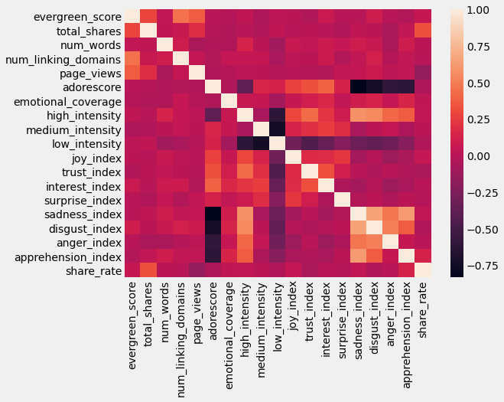
Exploratory Data Analysis
Ranking sentiment against share rate showed some correlation between metrics, however- analyses returned model accuracy scores of less than 5% (even after scaling the data), making it apparent that there are no strong correlations between share rates and any kind of sentiment expressed in an article title (let alone positive sentiment, as I had hypothesised).

Slide 5
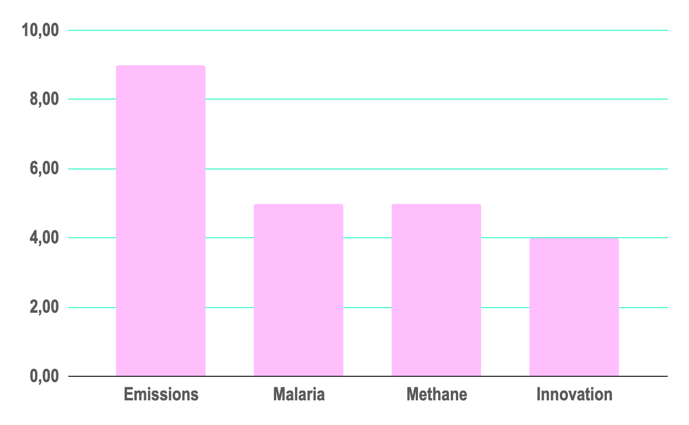
The Solution
Recommendations
Whilst I started off analysing for correlations between sentiment and shares and found that surprisingly, there are none - I am able to provide a solution to the client where I have identified 4 content topics that engage audiences, off the back of my exploratory data analysis.
Top keywords ranked by share rate
Calculated as an aggregation across all articles containing a given keyword.

Slide 6
In Summary
Findings
Next Steps
Using the average share rate (of 3.04) as a basis, we can see that articles published on the following content topics: Emissions, Malaria, Methane & Innovation, are able to drive above average share rates - therefore producing content on these particular topics is likely to drive up share rates.
Following this, I can A/B test articles, publishing content that does & doesn’t include these keywords and review results to validate this analysis.
Other analyses include:
Audience Preferences
Impact of Paid Media on Content Performance

